Slide 1
Cross-Validation & Bootstrap
DEVAKANTH KALAPATI
CHENXIN XIE
EDUARDO ALFONSO RAZO
An Introduction to Statistical Learning – with Applications in R
Chapter 5: Resampling Methods

Slide 2

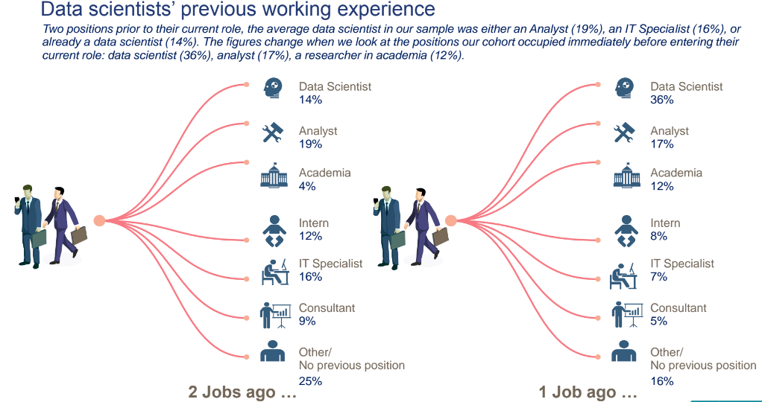

Prediction
Notes:
https://www.google.com/imgres?imgurl=https%3A%2F%2Fitstaffing.com%2Fwp-content%2Fuploads%2FData-Scientist-4.jpg&imgrefurl=https%3A%2F%2Fitstaffing.com%2Fdata-scientist-career-future%2F&tbnid=geR4nHBaWdnR-M&vet=12ahUKEwillJec2MznAhXGwYUKHZsOC8oQMygAegUIARCHAg..i&docid=CqdYhTVMCdxvsM&w=774&h=1442&q=data%20scientist&ved=2ahUKEwillJec2MznAhXGwYUKHZsOC8oQMygAegUIARCHAg
https://www.datasciencecentral.com/profiles/blogs/the-typical-data-scientist-profile-in-a-few-pictures

Slide 3
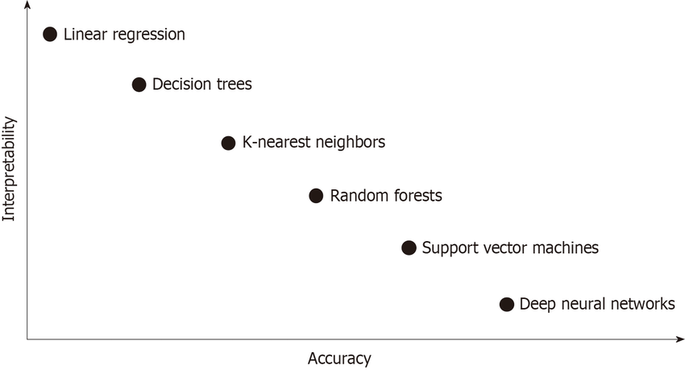
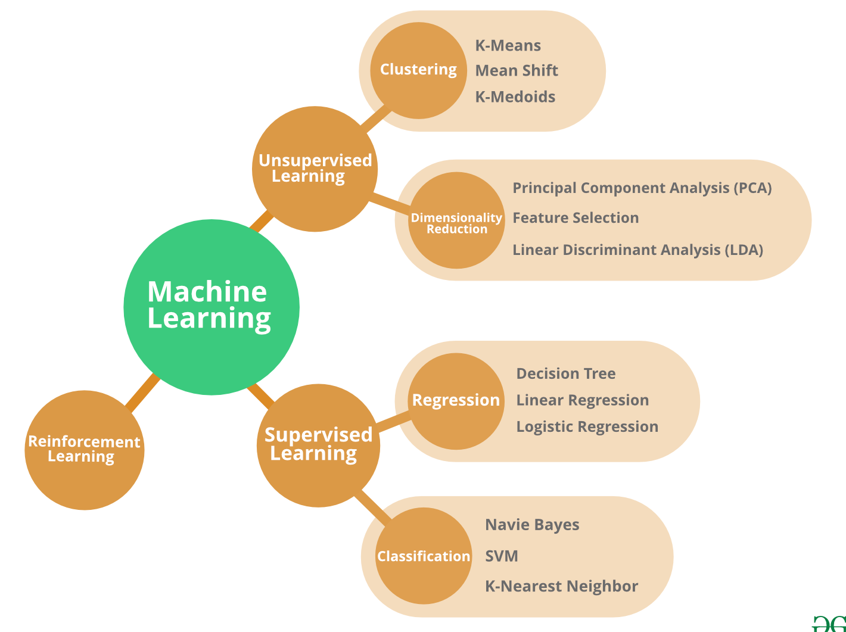
Which should we choose?
Notes:
https://www.google.com/imgres?imgurl=https%3A%2F%2Fwww.researchgate.net%2Fprofile%2FChang_Seok_Bang%2Fpublication%2F332409898%2Ffigure%2Ffig2%2FAS%3A753288945340417%401556609488850%2Fnterpretability-accuracy-tradeoff-in-classification-algorithms-of-machine-learning.ppm&imgrefurl=https%3A%2F%2Fwww.researchgate.net%2Ffigure%2Fnterpretability-accuracy-tradeoff-in-classification-algorithms-of-machine-learning_fig2_332409898&tbnid=eeeuLqKfvYzJ2M&vet=12ahUKEwivpvXnqMrnAhUHNhoKHdncCt0QMygIegUIARD_AQ..i&docid=4bhOgAOfYpHPNM&w=850&h=464&q=machine%20learning%20classification%20algorithms&ved=2ahUKEwivpvXnqMrnAhUHNhoKHdncCt0QMygIegUIARD_AQ
https://www.google.com/imgres?imgurl=https%3A%2F%2Fwww.natureknowsproducts.com%2Fwp-content%2Fuploads%2F2019%2F05%2FMachineLearning.png&imgrefurl=https%3A%2F%2Fwww.natureknowsproducts.com%2Fthe-10-algorithms-every-machine-learning-engineer-should-know%2F&tbnid=ZqAADT1_esEgEM&vet=12ahUKEwivpvXnqMrnAhUHNhoKHdncCt0QMygGegUIARD7AQ..i&docid=g0yvzj1qdFZkvM&w=1500&h=1139&q=machine%20learning%20classification%20algorithms&ved=2ahUKEwivpvXnqMrnAhUHNhoKHdncCt0QMygGegUIARD7AQ

Slide 4
Key concepts
Resampling methods
Repeatedly draw samples from a training set and refit a model of interest on each sample in order to obtain additional information about the fitted model
Model assessment
Process of evaluating a model’s performance
Model selection
Process of selecting the proper level of flexibility for a model

Slide 5
Cross-Validation

Slide 6
Cross Validation – Why?
Validation and assessment of effectiveness
Need of assurance that the model gets most of the patterns from the data.
To reduce bias and variance.
Need to mitigate underfitting or overfitting.
Calculate and reduce test error rate.
Holding out a subset of the training observations from the fitting process.

Slide 7
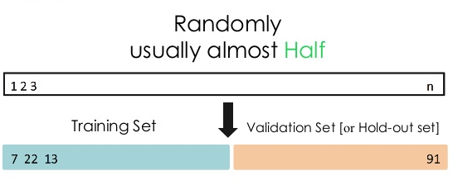
Cross Validation Approaches
Validation set approach
Used to calculate test error associated with fitting a particular statistical learning method.
Randomly divides the data in two parts (training and validation set).
The model is fit on the training set, and then, used to predict responses in the validation set.
The validation set error rate provides an estimate of the test error (MSE).

Slide 8
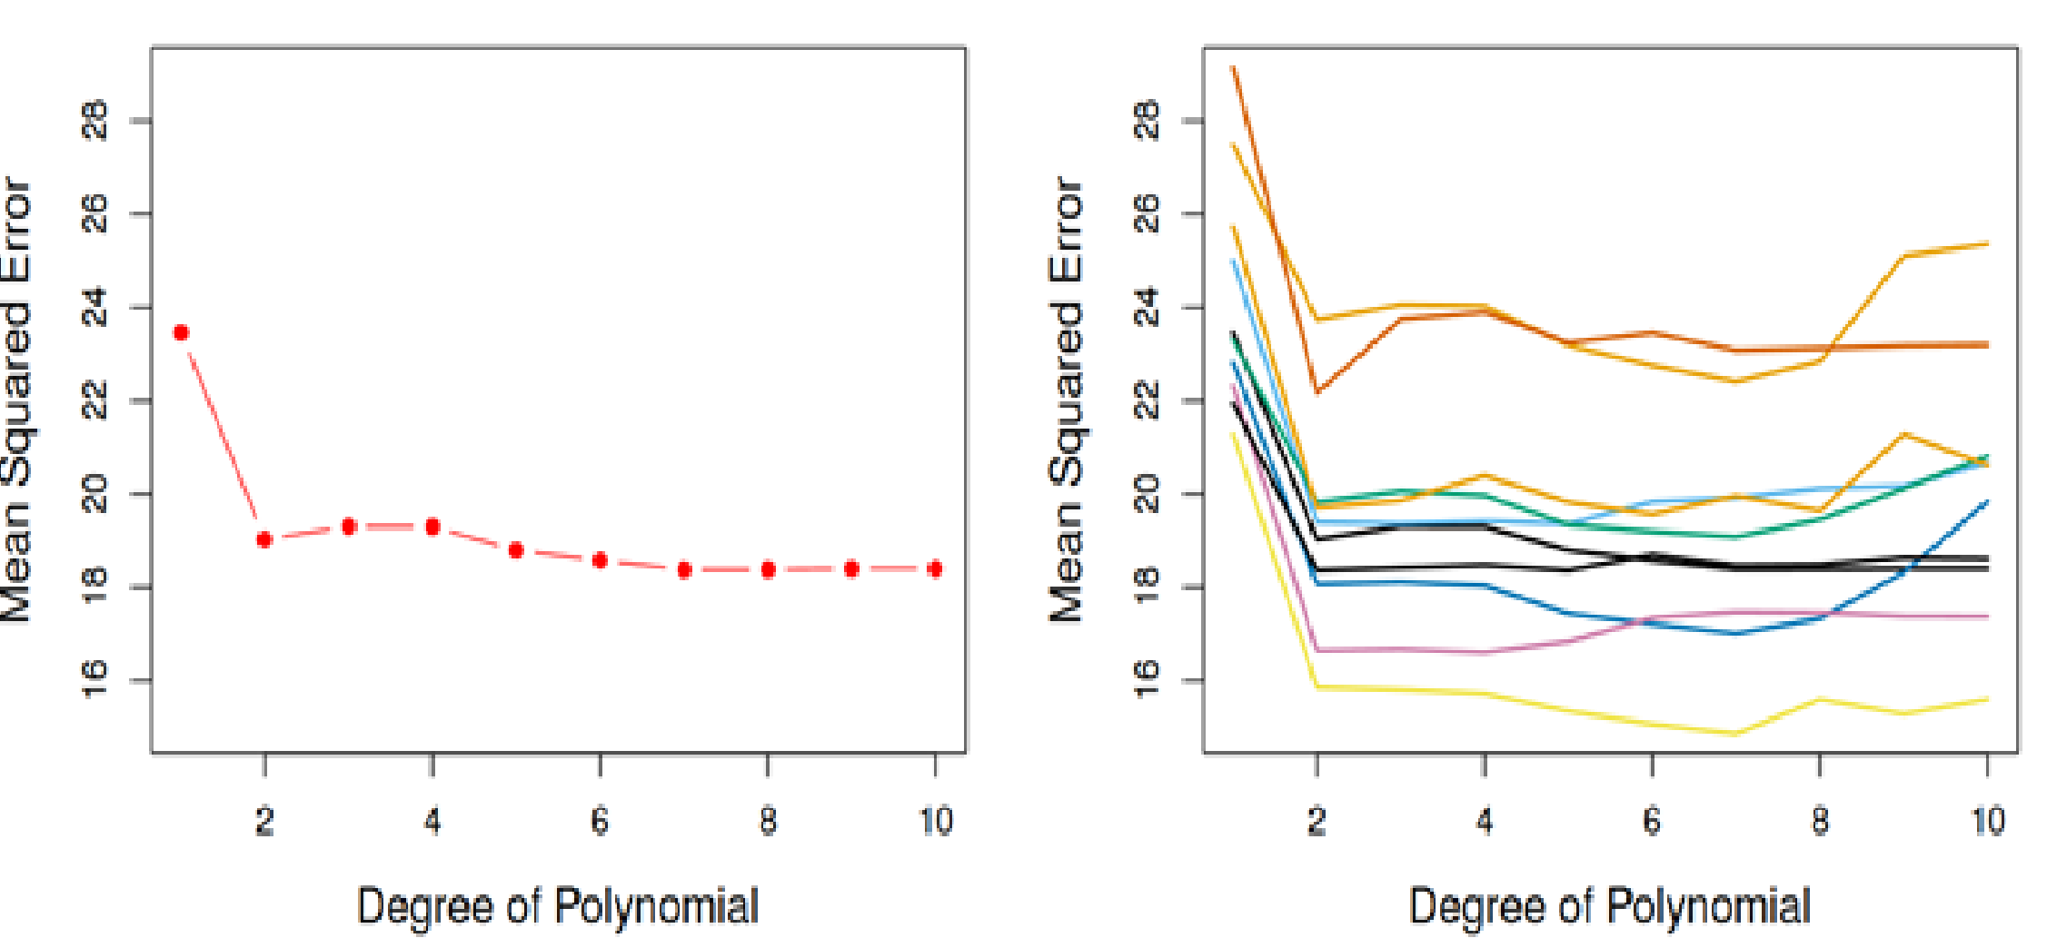
Cross Validation Approaches
Disadvantages:
The validation set error rate may tend to overestimate the test error rate for the model fit on the entire data set.
The estimation of the test error rate can be highly variable. Depending on how the samples for the training and validation sets are conformed.

Slide 9
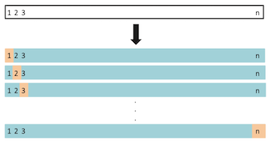
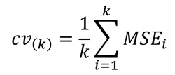

Cross Validation Approaches
Leave-One-Out (LOOCV):
This method is similar to validation set approach, but it tries to address its drawbacks.
Training data set: n -1
Validation data set: 1
The model is fit on the training observations.
The process is executed as many times as n observations.
Validates model on validation data by calculating MSE.

Slide 10
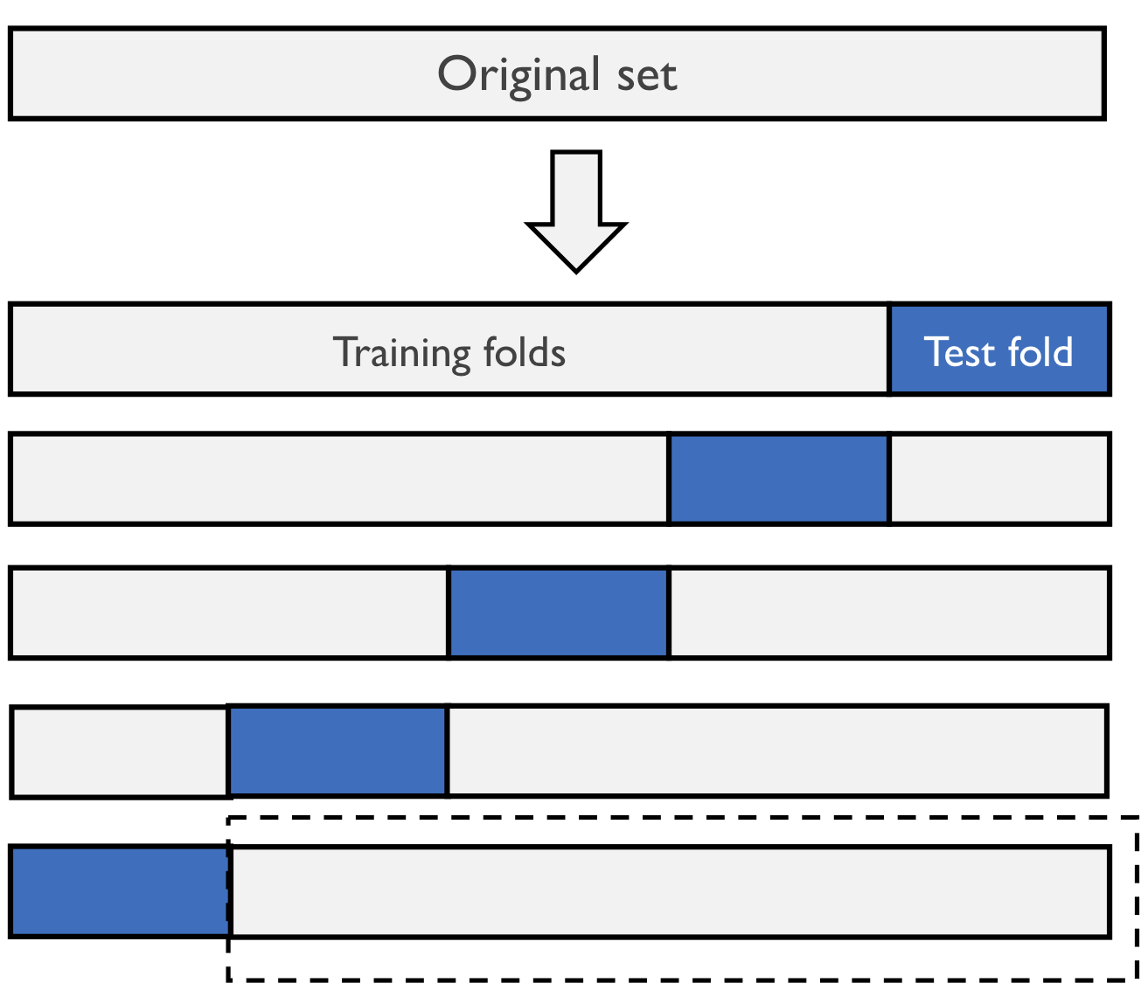
Cross Validation Approaches
K – Fold :
Divides the data set into k different parts or folds (typically k=5 or k=10).
Training data set: k -1 folds
Validation data set: fold
The model is fit on the training observations.
The process is executed k times.
Validates model on validation data by calculating MSE.

Slide 11
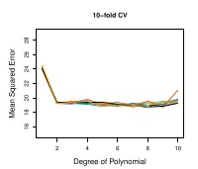
Bias-Variance Trade-off for k-Fold validation
When k < n, k-fold has a computational advantage on LOOCV.
K- fold CV gives more accurate estimates of the test error rate.
Since LOOCV has more training data, is less bias than k-fold CV.
Since LOOCV trains n models on almost identical set of observations, these are highly correlated and LOOCV has a higher variance than k-fold CV.

Slide 12
Cross Validation Classification Problems
Similar application when Y is qualitative.
Divides data into k parts.
The model is fit using the remaining data and calculates the error rate on the test set.
Repeat k times.
Quantification of error: Number of misclassified observations rather than using MSE.

Slide 13
Bootstrap

Slide 14
Bootstrap
The bootstrap is a flexible and powerful statistical tool that can be used to quantify the uncertainty associated with a given estimator or statistical learning method.
It can provide a estimate of the standard error of a coefficient, or a confidence interval of a coefficient.

Slide 15
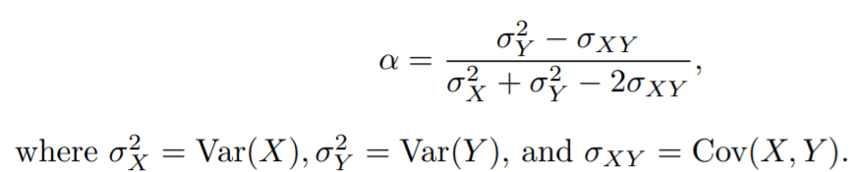
Example
Suppose we wish to invest an amount of money in two assets which yield return of X and Y respectively.
We invest a fraction α of our money in X and the remaining 1 – alpha in Y.
We try to choose alpha which can minimize the risk.
Var(αX + (1-α)Y)
The value which minimizes risk is given by

Slide 16
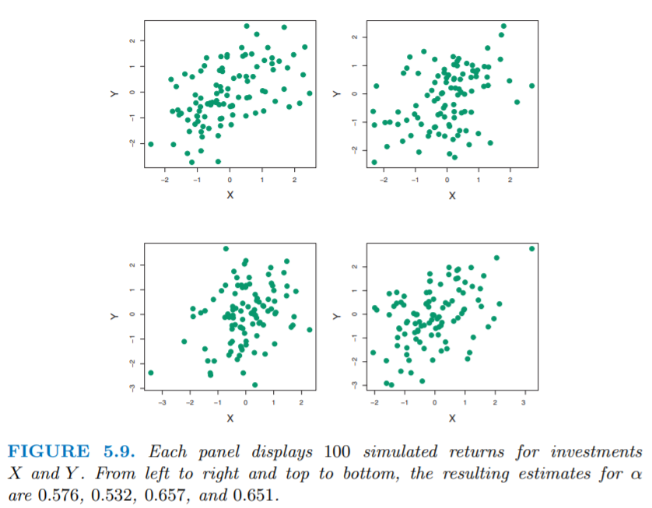
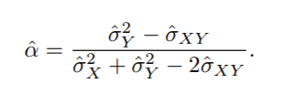

Slide 17

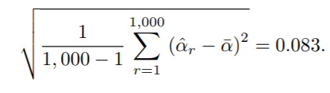

Suppose we simulate 100 paired observations of X and Y 1000 times.
We there by obtain 1000 estimates of α.
In reality the parameters for these simulations were set to

Slide 18
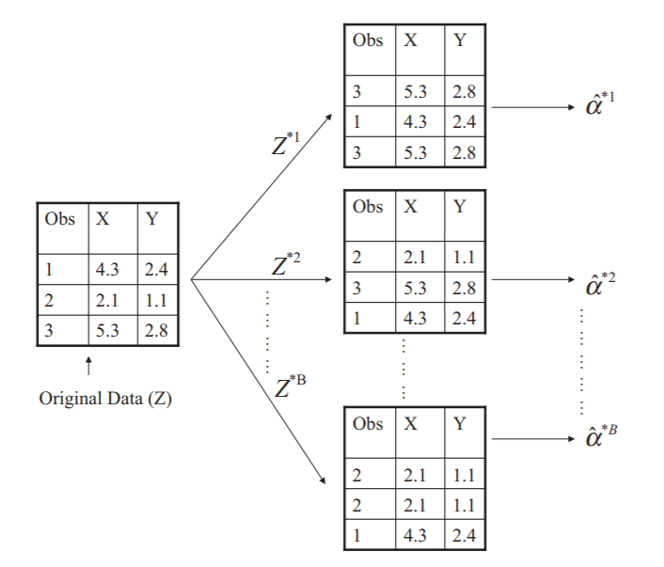
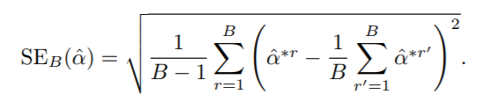
Resampling
In reality we cannot generate new samples from the population.
We can generate bootstrap data sets by sampling the original data set with replacement and same size as the original data set.
Bootstrap data sets

Slide 19
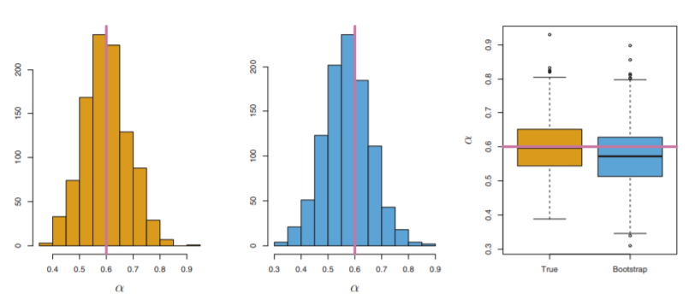
Actual
Resample
SE(ˆα) = 0.083
SEB(ˆα) = 0.087
Bootstrap Percentile Confidence Interval
X% Confidence
α = 1 – X% Intervals -> α/2 1 – α/2

Slide 20
Thank You!

